Slide 1
PROJ 216 Software Project Concepts
Day 3

Slide 2
Topics
HR Resource and Communications Management
Software Development Methodologies
Agile Software Development
User Stories

Slide 3
“The P in PM is as much about ‘people management’ as it is about ‘project management’. ”
— Cornelius Fichtner

Slide 4
Importance of HR Management
People determine the success and failure of organizations and projects
In IT field, qualified people are hard to find and keep
Project human resource (HR) management includes the processes required to make the most effective use of the people involved with a project

Slide 5
Challenges of IT Jobs
Globalization
Retiring “baby boomer” generation
Excessive work hours
Gender imbalance
AI
Any comments? Do you see any other problems?

Slide 6
HR Management Plan
Identifying and documenting project roles, responsibilities, and reporting relationships
Contents include:
Project organizational charts
Staffing management plan
Responsibility assignment matrix
Resource histogram – a column chart that shows the number of resources needed over time

Slide 7
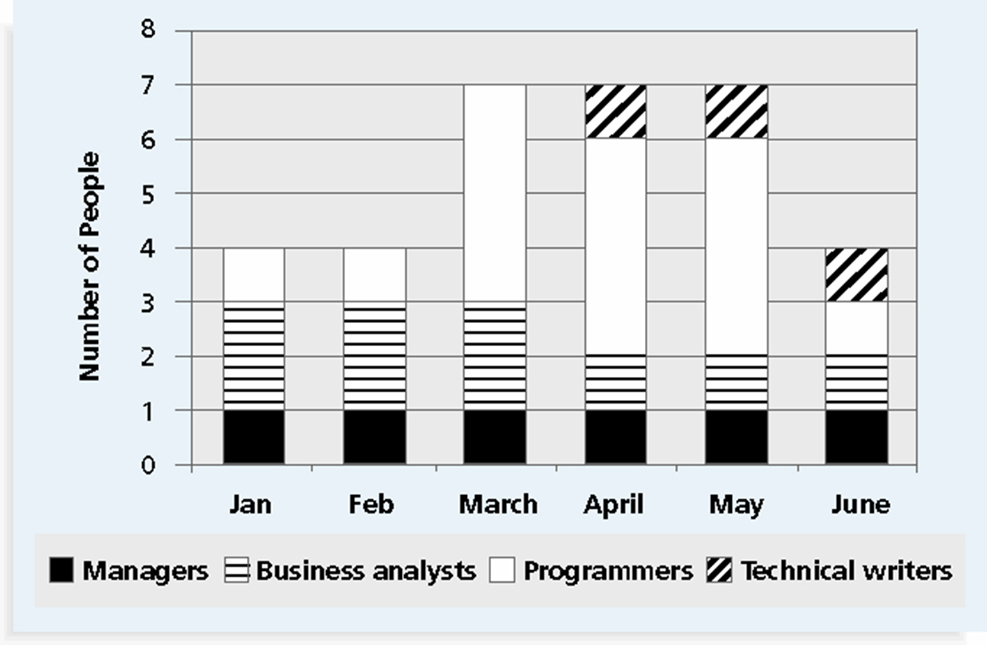
Resource Histogram Example

Slide 8
Beyond HR Management Plan
Acquiring the team
Developing the team: building individual and group skills to enhance project performance, training
Managing the team: tracking performance & providing feedback, motivating, resolving conflicts
Bottom line:
Treat people with consideration and respect
Understand what motivates them
Communicate carefully with them
Enable team members to deliver their best work

Slide 9
Communications Management
Initiating:
Identify stakeholders
Plan communications
Executing:
Distribute information
Manage stakeholders expectation
Monitoring and Controlling:
Report performance
Progress reports
Change requests

Slide 10
Identifying Stakeholders
The ultimate goal of project management is to meet or exceed stakeholder needs and expectations, so you must first identify who your project stakeholders are
Two key outputs of this process include:
Stakeholder register: a public document that includes details related to the identified project stakeholders
Stakeholder management strategy: an approach to help increase the support of stakeholders throughout the project; often includes sensitive information

Slide 11
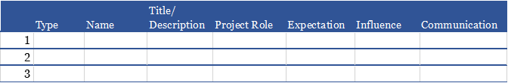
Stakeholders Register
A document that identifies and classifies project stakeholders, including their involvement in the project (expectation) and influence level
https://projectmanagementacademy.net/resources/blog/what-is-a-stakeholder-register/

Slide 12
Communication Plan
Stakeholder communications requirements
Information to be communicated, including format, content, and level of detail
The people who will receive the information and who will produce it
Suggested methods or technologies for conveying the information

Slide 13
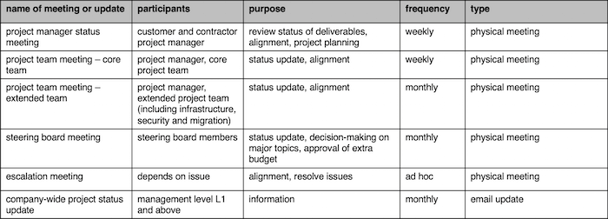
Communication Plan Example
https://www.tacticalprojectmanager.com/communication/communication-plan/

Slide 14
Reporting performance
Performance reporting keeps stakeholders informed about how resources are being used to achieve project objectives:
Status reports describe where the project stands at a specific point in time
Progress reports describe what the project team has accomplished during a certain period of time
Forecasts predict future project status and progress based on past information and trends

Slide 15
Effective technical presentations
What are your tips for delivering effective technical presentations? Share your ideas
Your body language affects not only your audience but also yourself:
http://www.ted.com/talks/amy_cuddy_your_body_language_shapes_who_you_are

Slide 16
Software Development Lice Cycle (SDLC)
Analysis
Feasibility study
Analysis of the current system
Analysis of user requirements
Selection of a solution approach
Hardware and software acquisition
Design
Detailed Design
Implementation
Writing code, testing, integrating
Deployment
Maintenance
Making changes, fixing bugs

Slide 17
Software Development Methodologies
https://acodez.in/12-best-software-development-methodologies-pros-cons/
Structured Design
Waterfall Development
Parallel Development
Rapid Application Development
Phased Development
Prototyping
Throwaway Prototyping
Agile Development

Slide 18
Software Development Methodologies – 30 minutes
In your project teams, research assigned software development methodology, and prepare a short presentation (5 minutes)
What is it? What are the pros and cons? When to use it? How does it compare with other approaches?
Team 1: Waterfall
Team 2: Parallel
Team 3: Phased
Team 4: Prototyping
Team 5: Throwaway prototyping
Team 6, 7: Agile
Each group will deliver presentation to the rest of the class

Slide 19
User Stories
User stories are part of Agile software development
Conversations about the desired functionality
A short, simple descriptions of a feature told from the perspective of a person who desires a new capability
https://www.mountaingoatsoftware.com/agile/user-stories
User stories exercise – see separate file

Slide 20
Introducing Group Assignment 3 – User Stories

